Slide 1

IOS & Android app
Marketing Presentation

Slide 2

Our Story

Slide 3
Contents
About & Purpose
AnimalTrack Team
APP Details
Actions
End of Presentation

Slide 4

Purpose
The AnimalTrack app allows users to take photos of animals/insects. It identifies the species and plots it on a map where every user can see.
After time, the app will generate a graph that can be sent to animal/environmental organizations around the world.
This app helps and makes people aware of our environment.

Slide 5
Team
Team Leader: James Tan.
Product Design: Emma Bi, Samuel Williams, Michael Peng, Ty Collver, and Henry Cawse.
Programmers: Jim Wang, James Tan

Slide 6
About AnimalTrack Part 3

Slide 7
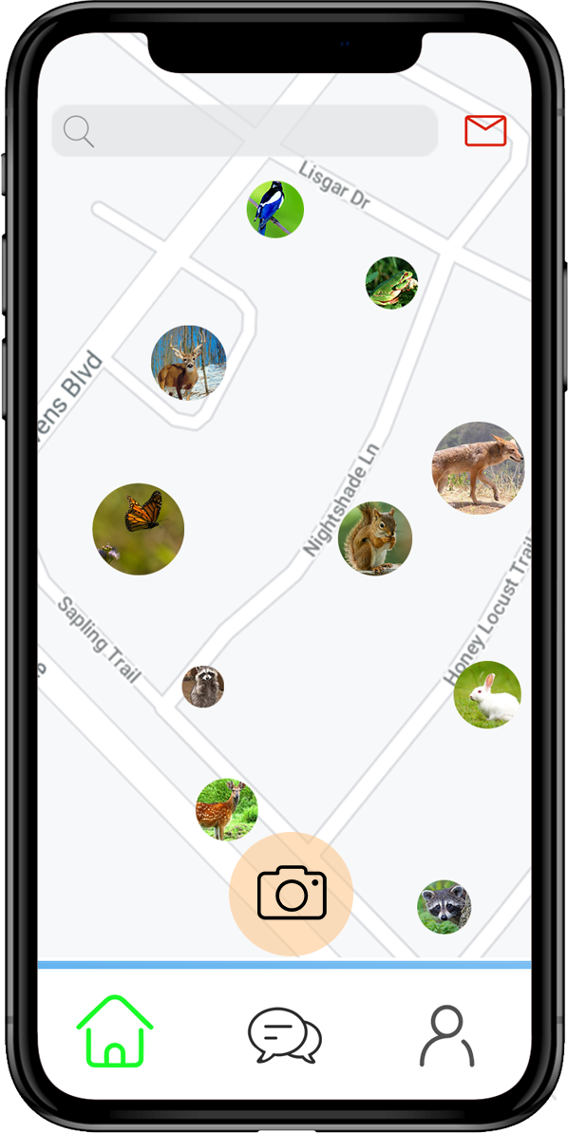
Home Page

Slide 8
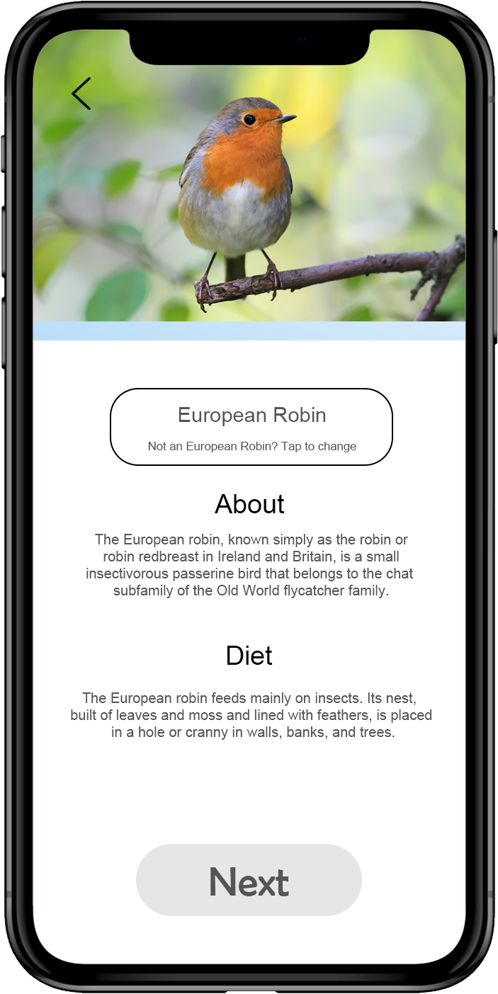
Identify Page

Slide 9






Comment
Passwords
Like
Filter
AI
Sections & Communities

Slide 10
Community Leader System
This system will allow users to create forums and hide other’s posts.
To become a community leader, you must do the following:
Users must be a member in that community;
Users must have more than 500 contribution points;
They must be in the top 10% in their community;
Users must upload more than 3 photos per week to maintain their role as a community leader;

Slide 11

Contribution System
# of observations: 2 points per photo
# of species: 4 points per different species that you upload
# of people invited: 20 points per invited guest
# of posts or other elements that you shared through other social media platforms: 8 points per share
# of likes obtained: 1 point per like
# of likes sent: 1 point per like
# of comments obtained: 1 point per comment
# of comments sent: 1 point per comment

Slide 12

Points System Community & Sections
The point system for communities and sections is on a 5-base scale

Slide 13

AI Identification System
When a user takes a photo, the AI identifier will automatically identify what that image was and what species it was. The user can then change the species name if the AI was incorrect.

Slide 14

Default Positioning System Location & Points
When a user takes in a picture in Oakville the first time for example, Oakville will be their default location. If they travel to another city, and they take a photo there, then the locations of their accounts are in Oakville and the other city.

Slide 15

Forums System
Forums are a way for users to connect with each other and share actions that they did which they would like to share
Forums can only be created by community leaders
People in that community can join the forum if they are in the location
If you are not in the area where the forum is dedicated, then you can only see other’s conversation and you will not be able to comment.

Slide 16

Graphing System
Overtime, the database will generate a graph out of the collection of data and will be sent to administrators over a year or more
The data will be sent to environment and animal organizations, and they will analyze the trends of the graph
The graph is easily access through the app itself too
There is a graph of every animal species, and there will be amore generic graph displaying the total # of uploads

Slide 17

Actions Part 4

Slide 18
Actions that will help the APP grow
To inform friends and family about the APP
To give out letters to neighbors that tells them about the APP

Slide 19
End of Presentation

